Slide 1

Build the Enlightened Enterprise
An Overview of the Mortage process
From design to implementation with Signavio Process
Editor and JBoss BPM Suite
Powered by JBoss Enterprise Middleware -
Red Hat JBoss BPM Suite

Slide 2














JBoss Middleware becomes strategic
STRATEGY
PROCESSES
OPERATIONS
PEOPLE IT RESOURCES
Notes:
BPM Suite helps organizations to model and automate business processes combining people, data and applications, in all scenarios, from traditional to open hybrid cloud.

Slide 3

Components in Rewards project

Slide 4







Value Proposition
Automate
business operations
with intelligent
decision support
Optimize
business operations
with real-time BAM, analytics,
simulation and reccomendation
Accelerate
application development
with model-driven
design and integration
AHA!
HYBRID CLOUD
PRIVATE
CLOUD
PUBLIC
CLOUD
Empower
business users to
take control of operations
Collaborative working
during the entire process life cycle
and beyond the Enterprise
Deploy
in the Cloud
with BPM PaaS

Slide 5





Capabilities Overview
Processes Create and deploy enterprise processes and applications through a model-driven composition environment and execution platform. | Services Integrate and interoperate your existing enterprise systems and web services in your business processes using JBoss SOA Platform and JBoss Fuse modern ESB.
Rules JBoss BRMS is included in JBoss BPM Suite to support the definition, management and execution of business rules by Business and IT users. | Data Data modeling tool that also enables participants to manipulate and manage data entities within running processes.
Events Handle events as first class citizens of the platform, dedicating an independent module to Manage Complex Event Processing (CEP). | Forms Forms modeling tool to build dynamic and interactive web forms using using a WYSIWYG drag-and-drop interface.

Slide 6







Capabilities Overview
Analytics Build dashboards that deliver real-time business activity monitoring (BAM) and reporting with personalized information, measure and analyze key indicators to track process performance to make quick and effective decisions. | Simulation Establish, execute and analyse different simulation scenarios. Identify bottlenecks. Decide what are the optimal parameters and thresholds for your processes. Make effective recommendations.
Assets Pluggable multi-dimensional repository for knowledge representation of processes, rules, data and services to facilitate reusability, change management, governance and compliancy. | Workspace The execution environment provides a Rich User Interface (RUI) or Portal that centralize user participation, attending alerts and triggers, and notifying actions to each role across the entire process lifecycle.
Execution Integrated execution environment with separates engines for processes, tasks, evente and rules. Deploy in different application servers, on-premise or in cloud. | Development JBoss Workbench IDE lets developers easily extend, build and integrate process-based applications.

Slide 7






Full BPM lifecycle support
Modeling & Simulation
Integration & Deployment
Continuous Improvement
Monitoring & Analysis
Execution & Management

Slide 8
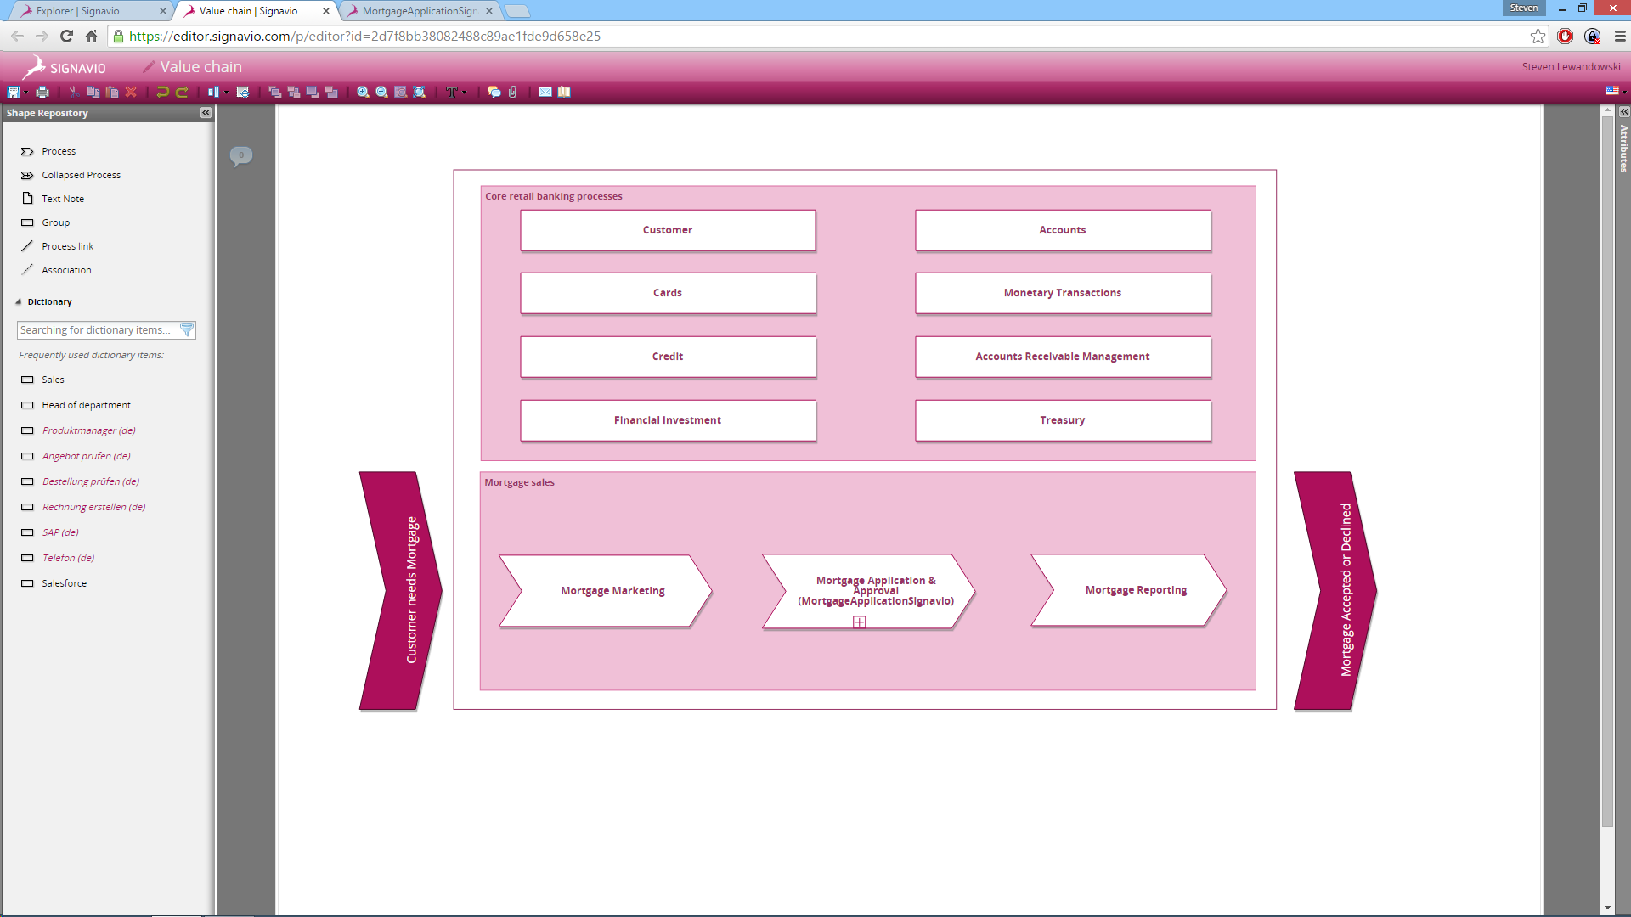
Signavio Process Editor Supply Chain view

Slide 9
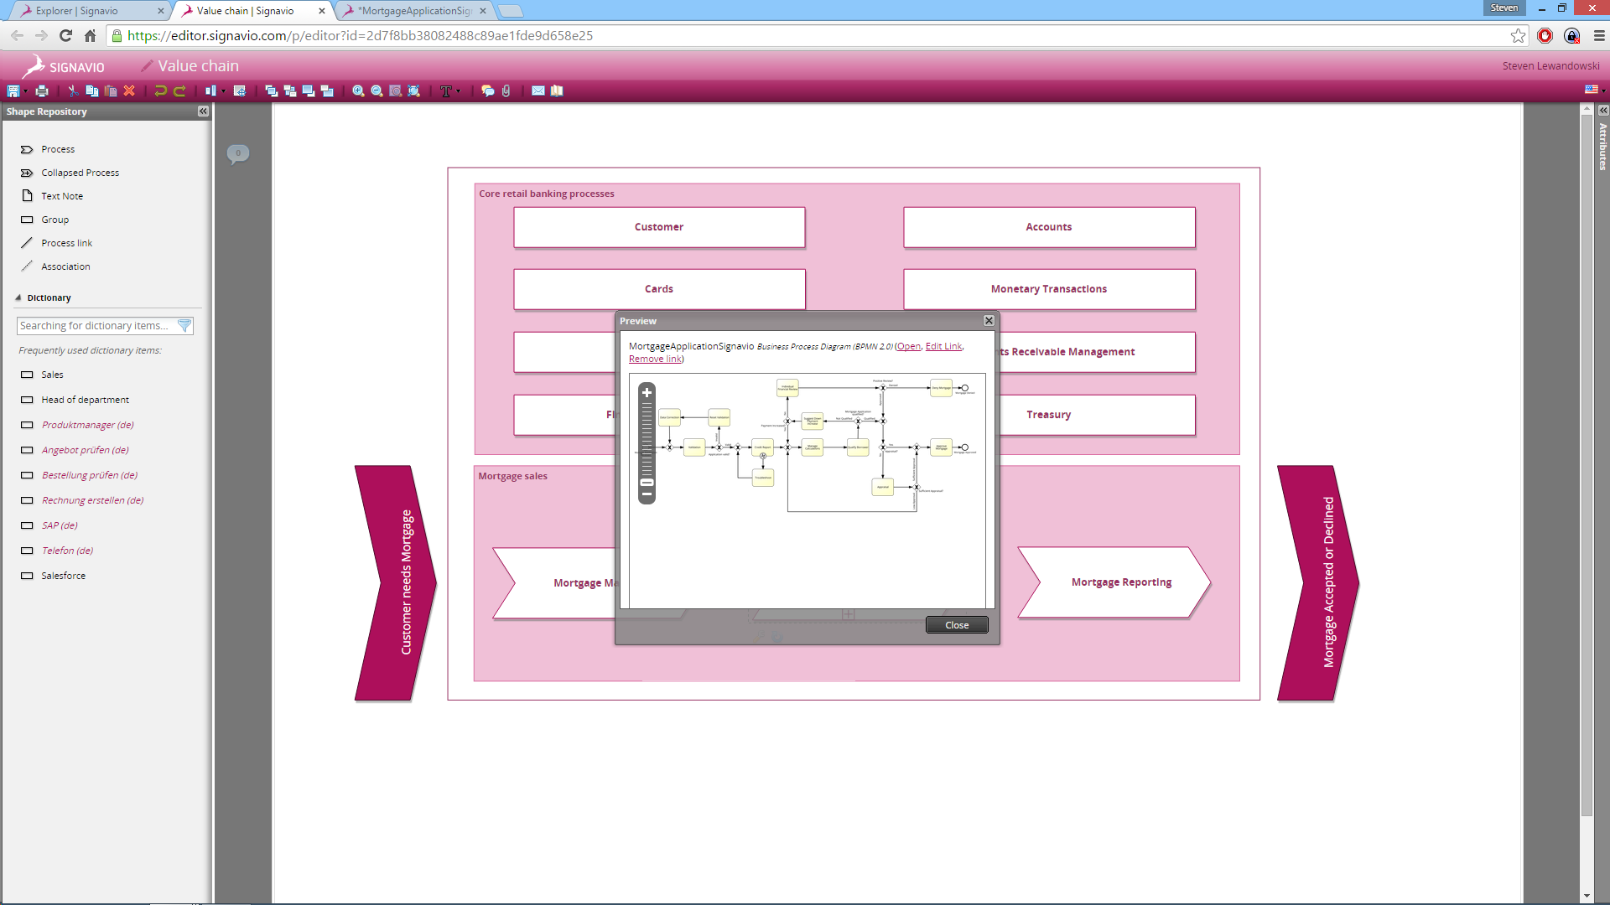
Signavio Process Editor Supply Chain preview

Slide 10
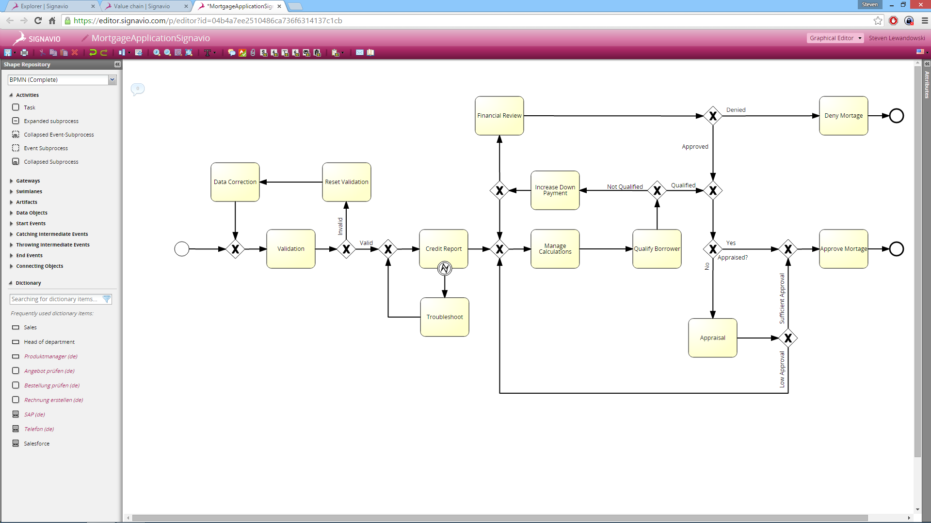
Signavio Process Editor Mortgage process

Slide 11
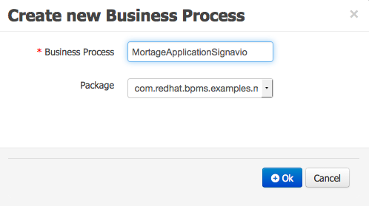
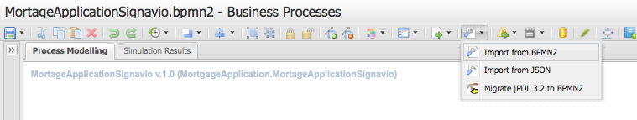
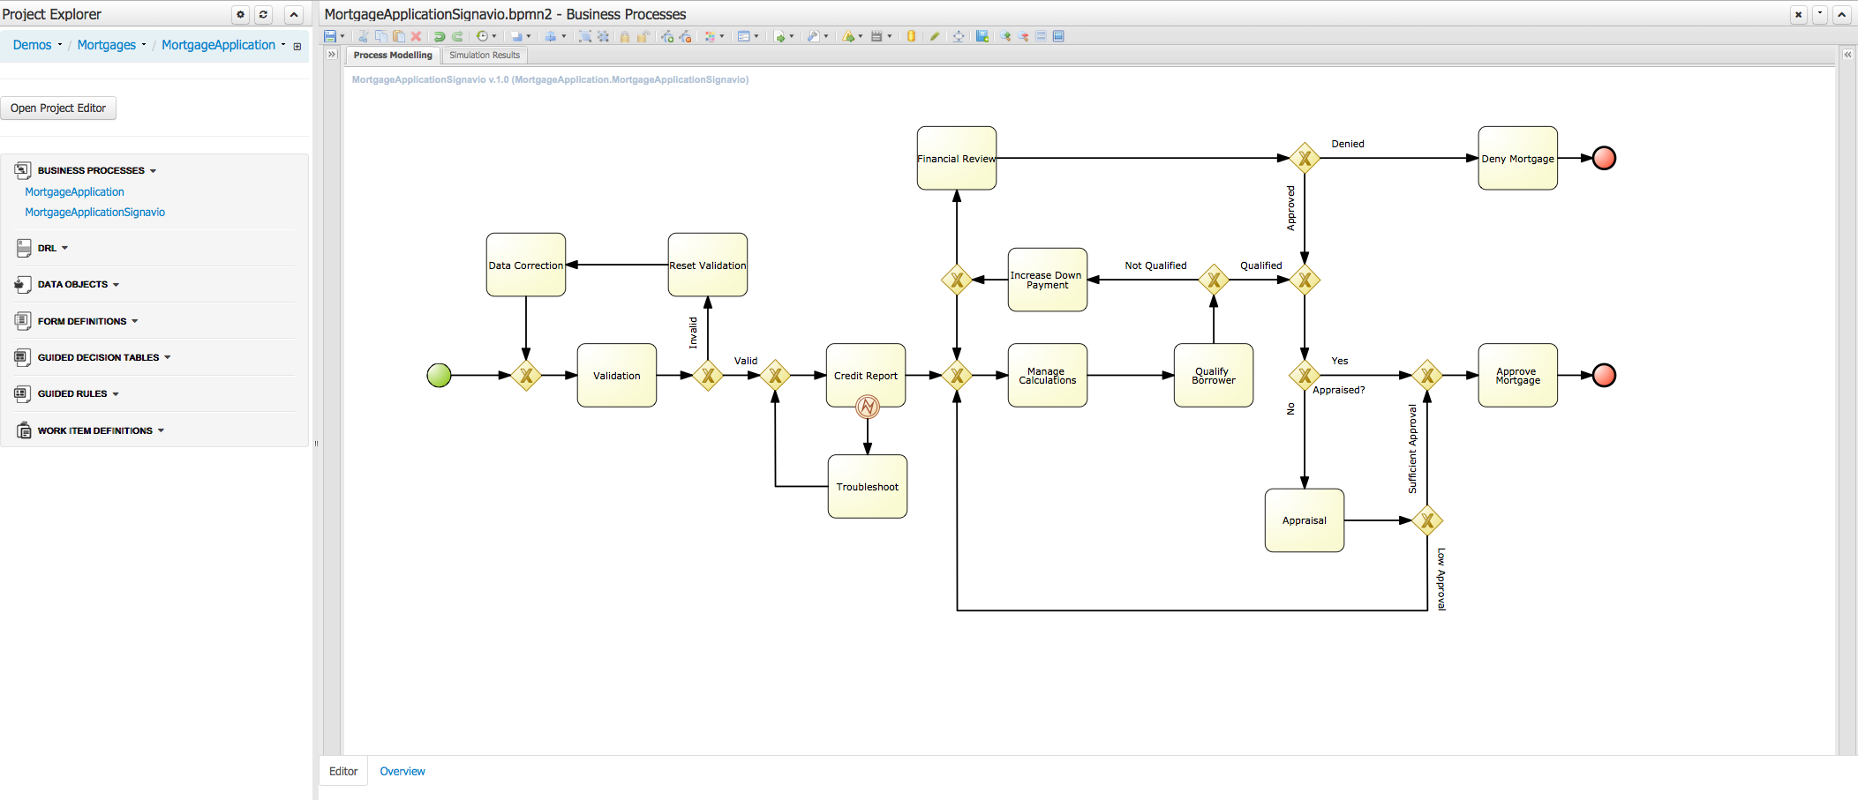
Import Signavio Process into JBoss BPM Suite

Slide 12
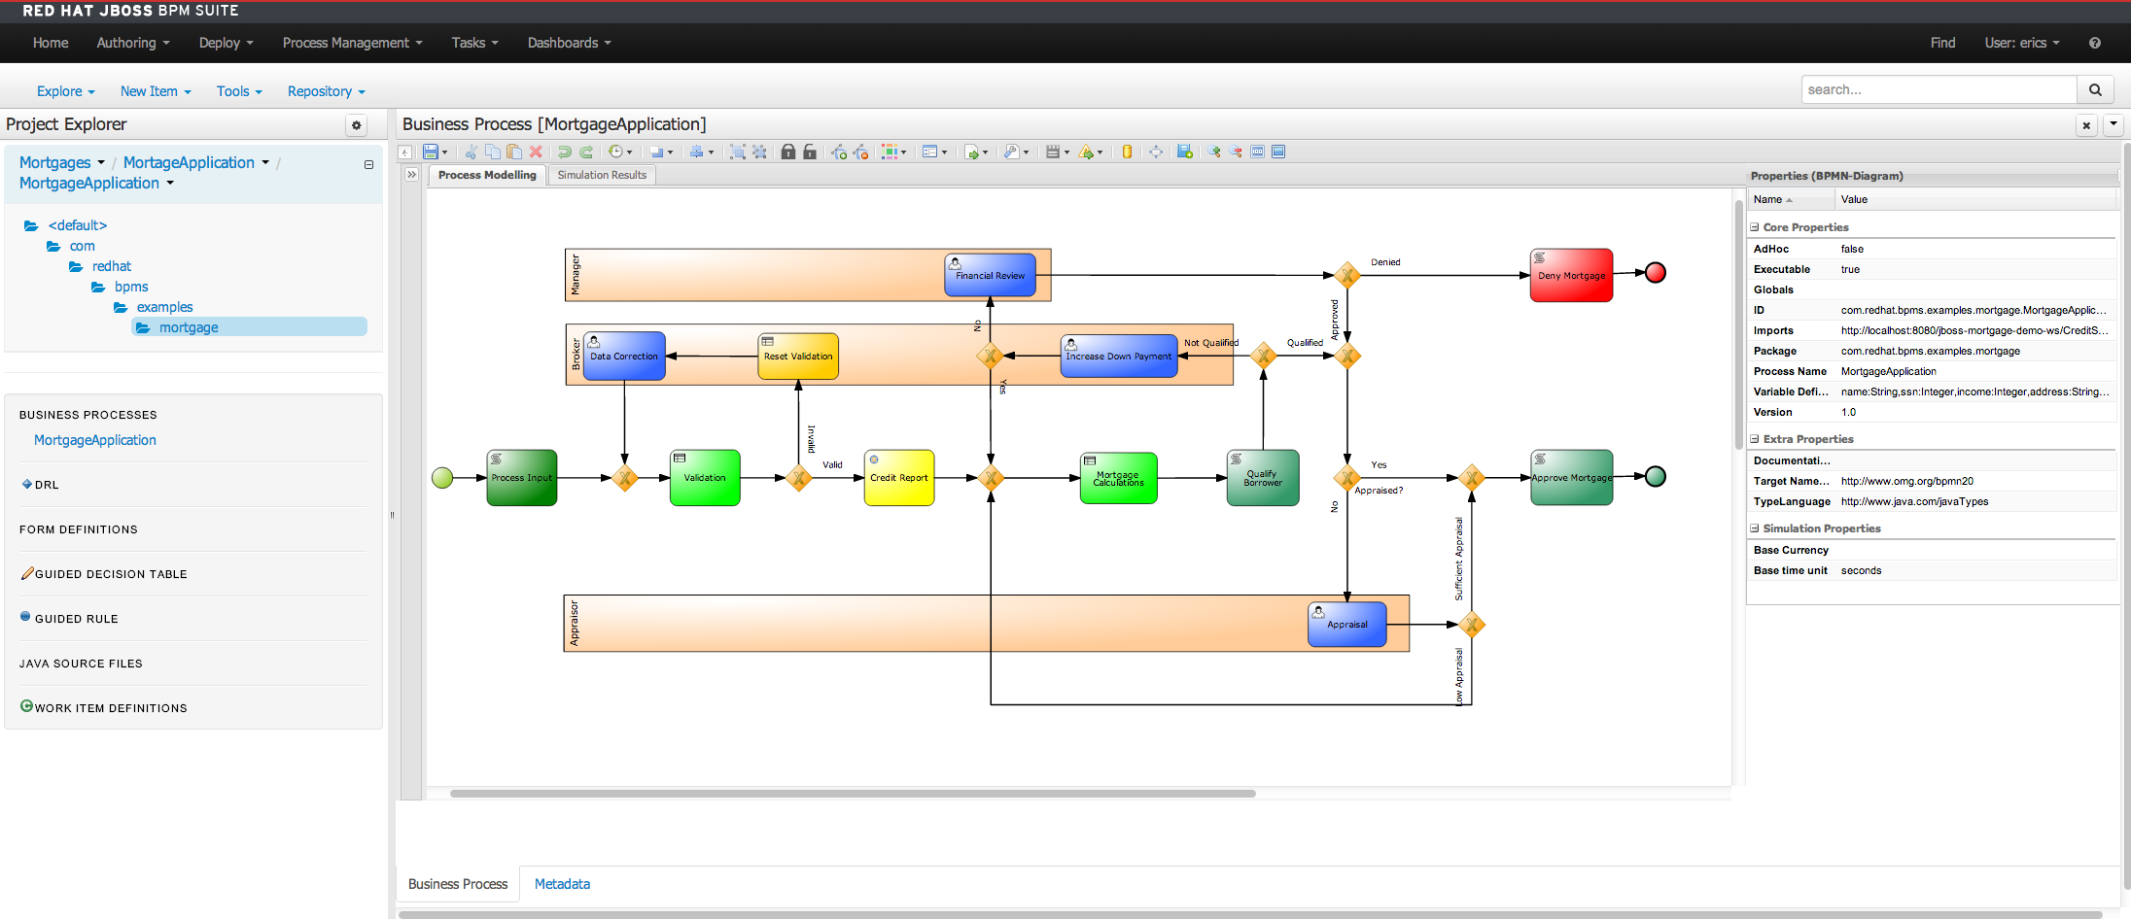
JBoss BPM Suite add implementation details

Slide 13
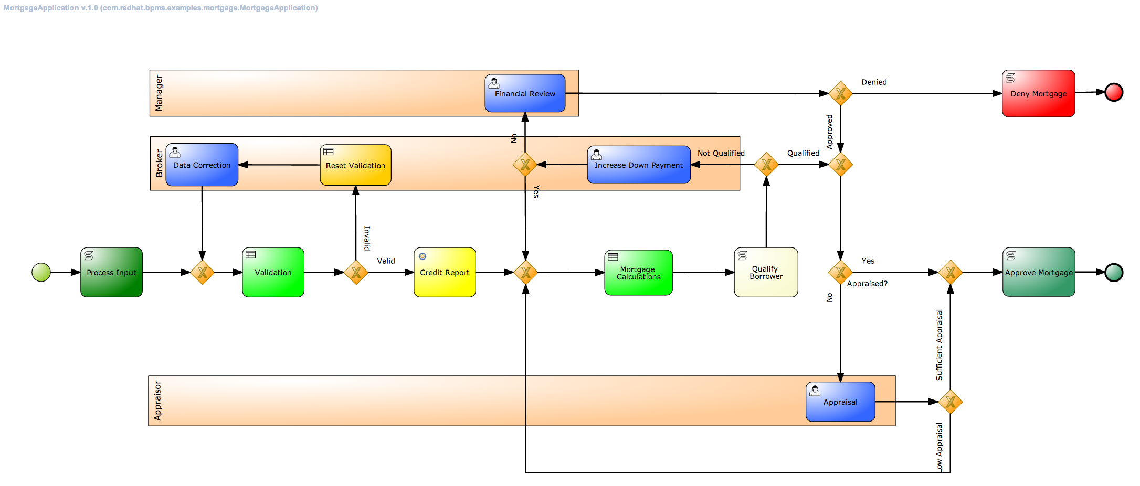
Mortgage process finished, ready to deploy

Slide 14
Build the Enlightened Enterprise
For more information, please visit
http://www.jboss.org/products
Demo project available at:
http://github.com/jbossdemocentral/bpms-signavio-integration-demo

